Slide 1



CAlifornia Common CORE state standards

Slide 2
History of CCSS
National State Governors Association
Council of Chief State School Officers
Work groups and feedback groups composed of representatives from higher education, K–12 education, business community, researchers, civil rights groups, and the states.
  Ensure students have a seamless transition from high school to college.
  Builds on the standards-based process.

Slide 3

Overarching Goals for K-12 CCSS
Ensure that our students are:
  Meeting college and work expectations.
  Prepared to succeed in our global economy and society.
  Provided a vision of what it means to be an academically literate person in the 21st century.
  Provided with rigorous content and applications of higher knowledge through higher-order thinking skills.
Provide a consistent, clear understanding of what students are expected to learn.
  Enables teachers and parents to know what to do to help.

Slide 4
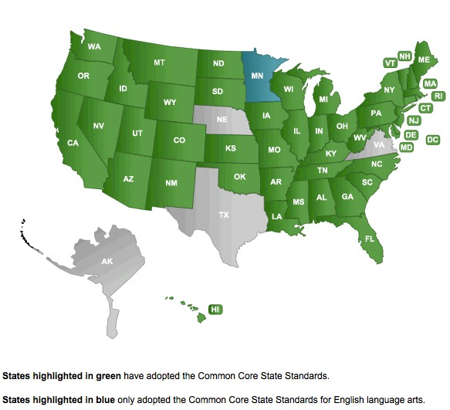
Which States Have Adopted?
3

Slide 5

California Adoption
"The California Common Core State Standards (CCSS) were adopted by the California State Board of Education on August 2, 2010, following rigorous review and augmentation by the California Academic Content Standards Commission." (O'Connell, 2010)

Slide 6
Business Support
“State by state adoption of these standards is an important step towards maintaining our country’s competitive edge … will be better prepared to face the challenges of the international marketplace.”
- Edward B. Rust Jr., Chairman and CEO, State Farm Insurance Companies
“America needs to remain globally competitive. This voluntary state-lead effort will help ensure that all students can receive the college and career ready, world-class education they deserve, no matter where they live.”
Craig Barrett, Former CEO and Chairman of the Board, Intel Corporation

Slide 7


What Do Employers Want?
Problem-Solving Skills
Quick Learners
Ability to Analyze/Interpret Data
Oral Communication Skills
Motivation
Self-Starter
Written Communication Skills
Job-Specific Computer Skills
Teamwork Attitude
Innovative Thinking

Slide 8


































Partners

Slide 9


Top 10
Most Critical Job Skills:
Critical Thinking
Complex Problem Solving
Judgment and Decision Making
Active Listening
Computers and Electronics
Mathematics
Operations and Systems Analysis
Monitoring
Programming
Sales and Marketing
Notes:
Published 12-2012

Slide 10

Top Jobs 2013
Human Resources, Training and Labor Relations Specialists
Network and Computer Systems Administrators
Sales Representatives (Wholesale and Manufacturing, Technical and Scientific)
Mechanical Engineers
Industrial Engineers
Software Developers
Accountants and Auditors
Market Research Analysts and Marketing Specialists
Computer Systems Analysts

Slide 11

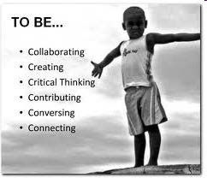
21st Century Skills
What skills will your children need to know to be successful in the 21st century
workforce?

Slide 12




Questions on Development of CCCS?

Slide 13


Focus of English Language Arts/Literacy
Rigor
Application of Learning to Real-World Situations
Technology and Media Sources
Justification and Evidence
Communication/Collaboration
Expository Reading and Writing
Research

Slide 14



Focus of Mathematics
Conceptual Understanding
Number Sense in Elementary
Multiple Solutions
Justifying Answer
Explaining Your Thinking
Success in Algebra and Higher-Level Mathematics
Application to Real World Situations

Slide 15

Anchor Standards
Skills needed in the workforce and life.
What students should be able to do when they leave high school.
Apply to all subjects.

Slide 16

How can families support their children in the transition to the Common Core State Standards (CCSS)?

Slide 17
Six Key Shifts in Literacy in Common Core
Informational text. | Do you encourage your child to read as much nonfiction as fiction? Do you discuss ideas in nonfiction texts?
Close reading of complex texts. | Do you read challenging texts with your children and help them see the value of the information?
Text-based answers and evidence. | Do you ask your children to show evidence from the text when answering questions?
Writing from sources with evidence. | Do you encourage your child to write using evidence and details from multiple texts?
Academic vocabulary. | Do you talk to your children using academic language?
Digital literacy. | Do your children use technology and media as a learning tool?

Slide 18

1. Informational Texts
http://www.reallygoodstuff.com/product/informational-text+posters+set.do

Slide 19
1. Informational Texts
Students must … | Parents can …
Read more nonfiction. Know the ways nonfiction can be put together. Discuss the details of nonfiction. Handle “primary” source documents. | Supply more nonfiction text. Read nonfiction texts aloud with child. Find books that explain. Model reading of non-fiction texts.
http://engageny.org/resource/shifts-for-students-and-parents/

Slide 20
2. Close Reading of Complex Texts
Students must … | Parents can …
Reread. Read material at comfort level AND work with more challenging stuff. Unpack text. Handle frustration and keep pushing. | Provide more challenging texts AND provide texts they WANT to read and can read comfortably. Know what is grade-level appropriate. Read challenging materials with them. Show that challenging material is worth unpacking.
http://engageny.org/resource/shifts-for-students-and-parents/

Slide 21
3. Text-Based Answers With Evidence
Students must … | Parents can …
Find evidence to support their arguments. Form judgments. Become scholars. Discuss what the author is “up to.” | Talk about text. Ask for evidence in every day discussions/disagreements. Read aloud or read the same book and discuss with evidence.
http://engageny.org/resource/shifts-for-students-and-parents/

Slide 22
4. Writing From Sources With Evidence
Students must … | Parents can …
Make arguments in writing using evidence. Compare multiple texts in writing. Write well. | Encourage writing at home. Write “books” together and use evidence/details. Look at Appendix A: http://www.corestandards. org/assets/Appendix_C.pdf
http://engageny.org/resource/shifts-for-students-and-parents/

Slide 23
5. Academic Vocabulary
Students must … | Parents can …
Learn the words that they can use in college and career. Get smarter at using the “language of power.” | Read often and constantly with babies, toddlers, preschoolers, and children. Read multiple books about the same topic. Let your kids see you reading. Talk to your children: read to your children; listen to your children; sing with your children; make up silly rhymes and word games with your children.
http://engageny.org/resource/shifts-for-students-and-parents/

Slide 24
6. Digital Literacy
6. Digital Literacy
Students must … | Parents can …
Use technology strategically. Produce and publish documents. Research, interact, collaborate, and communicate using web tools. Evaluate information presented in difference media formats. | Become familiar with technology. Monitor your child’s appropriate use of technology as a learning tool. Communicate with school for assistance with accessing technology and media.

Slide 25
Questions English Language Arts?

Slide 26

6 Shifts in Mathematics in the Common Core

Slide 27
Six Key Shifts in Mathematics in Common Core
Focus | What is the priority work for your child at his/her grade level?
Coherence | What did your child struggle with last year and how it will affect learning now?
Fluency | Has your child memorized the basic facts? Does your child spend time practicing lots of problems on same idea?
Deep Understanding | Does your child really KNOW why the answer is what it is?
Application | Do you encourage your child to DO the math that comes up in daily life?
Dual Intensity | Does your child practice the math facts he/she struggles with? Does your child think about math in real life?

Slide 28








1. Focus and 2. Coherence: Helping Your Child With Math
Be a Researcher:
  Ask questions that help you understand your child’s thinking.
  Be a thoughtful listener.
  Become knowledgeable about what content comes before and after your child’s current grade level.

Slide 29


3. Fluency
Understanding Fluency
  More than just memorization.
  Fluent with procedures, not just facts.
  Fluency enables students to understand and manipulate more complex concepts.

Slide 30


4. Deep Understanding: Explain Why
Teach children conceptual understanding first.
  Simply memorizing rules and procedures without understanding makes students unable to solve problems.
    All the drills in the world will not teach a math concept or idea.
  Once children have an opportunity to understand a concept, practice is very important to help them learn to use the skills with ease.

Slide 31







5. Application: Develop Problem Solvers
Reinforce that not all problems are solved quickly and directly.
Emphasize reasoning-not memorizing.
Remind that there is not one “right” way to solve any math problem.
Learn to recognize and connect very different ways to solve a problem.
Principles and Standards for School Mathematics National Council for Teachers of Mathematics

Slide 32





6. Dual Intensity: Helping Your Child With Math
Be a learner yourself:
  Learn to play with numbers using mental arithmetic.
  Play math games at home that involve problem solving.
  Notice how you use math in everyday life and share with your child.
  Demonstrate persistence.

Slide 33


Helping Your Child With Math
Be a Communicator:
  Recognize that talking and writing is important to learning math.
  Talk with your child about the many ways to think about a math problem.
  Encourage diverse ways of solving problems.

Slide 34


Ask the Right Questions
What have you tried?
Is there another way to look at the problem?
Can you explain this to me?
What makes sense so far?
Is there another way to think about it?
Is this like another problem that you have worked on?
What are you trying to do/solve/find out?

Slide 35

















Parental support and encouragement are vital to children’s mathematical development and success in school.
What parents do with their children is more important than who the parents are socially, economically, and educationally.
Shirley Frye
Parents as Partners

Slide 36
Questions on Math?

Slide 37
Student Assessments
Students will be assessed in Grades 3-5, 6-8, and 11 using Smarter Balanced Assessments.
Smarter Balanced is an adaptive assessment taken on the computer. All schools are being reviewed now to ensure that the technology is ready for this assessment.
Our current process of Universal Screening using the Scholastic Reading (SRI) and Scholastic Math Inventories (SMI) helps to prepare our students for this new assessment system.

Slide 38
CDE & SBAC Resources
CA Department of Education
http://www.cde.ca.gov/re/cc/
Smarter Balanced Assessment Consortium
http://www.smarterbalanced.org/

Slide 39
MVUSD Contact Information
Darren Daniel, Executive Director of Secondary Education
          ddaniel@murrieta.k12.ca.us
Mary Sousounis, Instructional Coach Math & Technology
          msousounis@murrieta.k12.ca.us
Susan Hall, Beginning Teacher Support, Instructional Coach Middle School Literacy and Academic Interventions
          shall@murrieta.k12.ca.us
Girlie Ebuen, Instructional Coach Math, Secondary
          gebuen@murrieta.k12.ca.us
Shannon Augustin, Instructional Coach Math, Secondary
          saugustin@murrieta.k12.ca.us

